Slide 1
Weekly Meeting 5/17/2024
JetRacer Soccer League

Slide 2
ROS/Hardware
Previous Work:
Finished ROS groundwork
Completed ZED2 camera swivel script
Started printing chassis
Future Work:
Implement movement strategy
Import custom dataset
Assemble car's upon print finish

Slide 3
Movement Strategy
Continue planning robot movement from CV outputs
Continued development of more complex striking
Tested ZED distance accuracy
Test state transitions
Determine method of angle and speed calculation with minimum latency
Improve striking

Slide 4
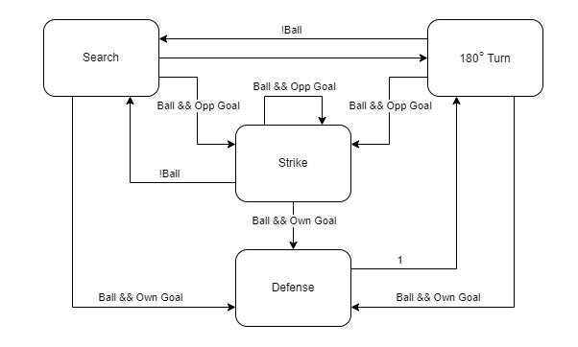

Slide 5
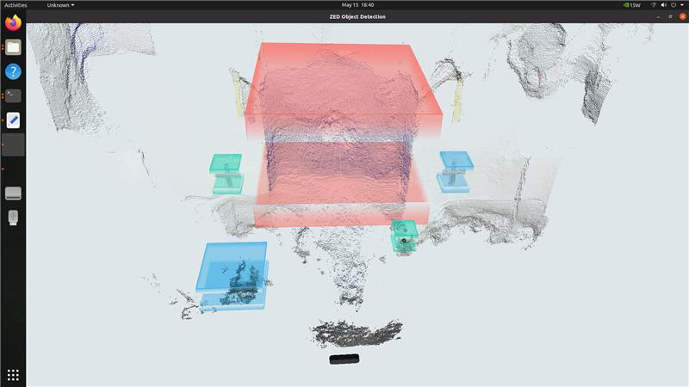

Slide 6
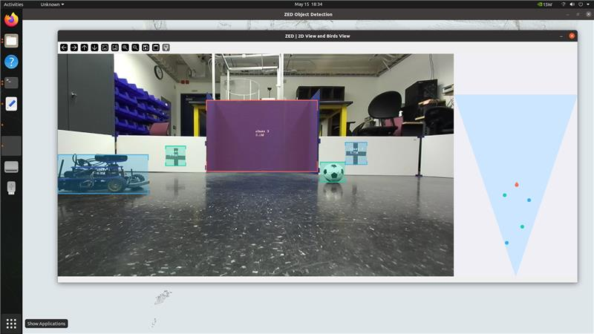

Slide 7
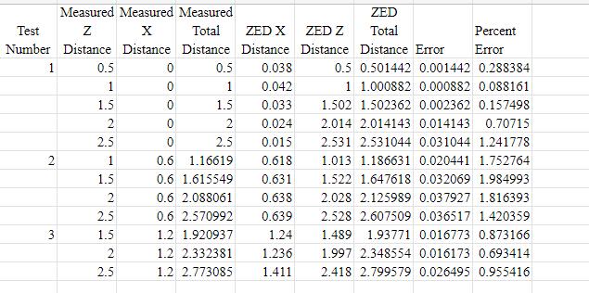

Slide 8
CV
Previous work:
Concluded primary work of CV which was to get a functional model running on the cars to provide perception inputs
Transitioning to other work items
Future work:
Work on implementing everything onto all cars
Update Github documentation

